Slide 1
Section 2.4 Deriving Quadratic Equations
i) Find the Q. E. when given two points or roots, one root is double/triple 2nd root
ii) Intersection b/n two parabolas
iii) Perfect Trinomials iv) For what values of “k” will there be 2roots, 1 root, or no roots
© Copyright all rights reserved to Homework depot: www.BCMath.ca

Slide 2
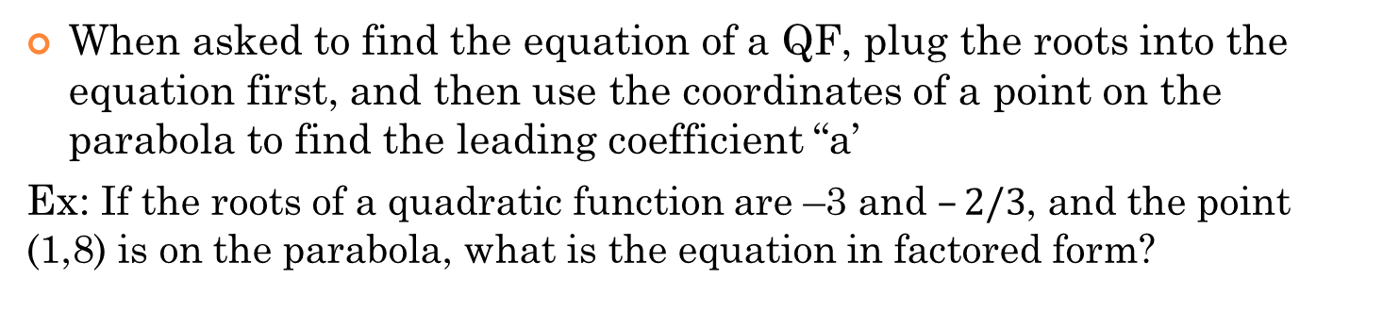
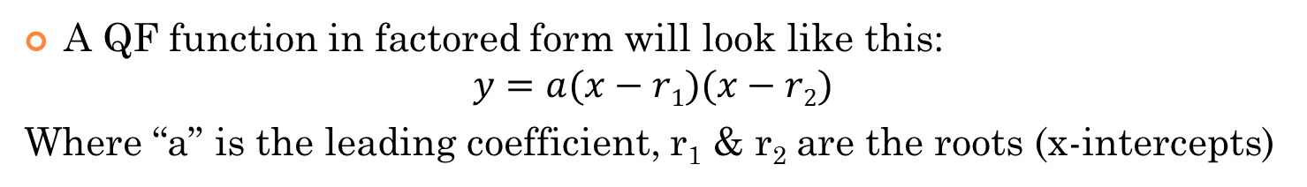
Quadratic function in Factored Form
A QF function in factored form will look like this:
$$y=a(x−r1)(x−r2)$$
Where “a” is the leading coefficient, r₁ & r₂ are the roots (x-intercepts)
When asked to find the equation of a QF, plug the roots into the equation first, and then use the coordinates of a point on the parabola to find the leading coefficient “a’
Ex: If the roots of a quadratic function are –3 and $–2/3$, and the point (1,8) is on the parabola, what is the equation in factored form?
Now plug in the coordinates of the point provided to solve for “a”
So the equation of the parabola will be:

Slide 3
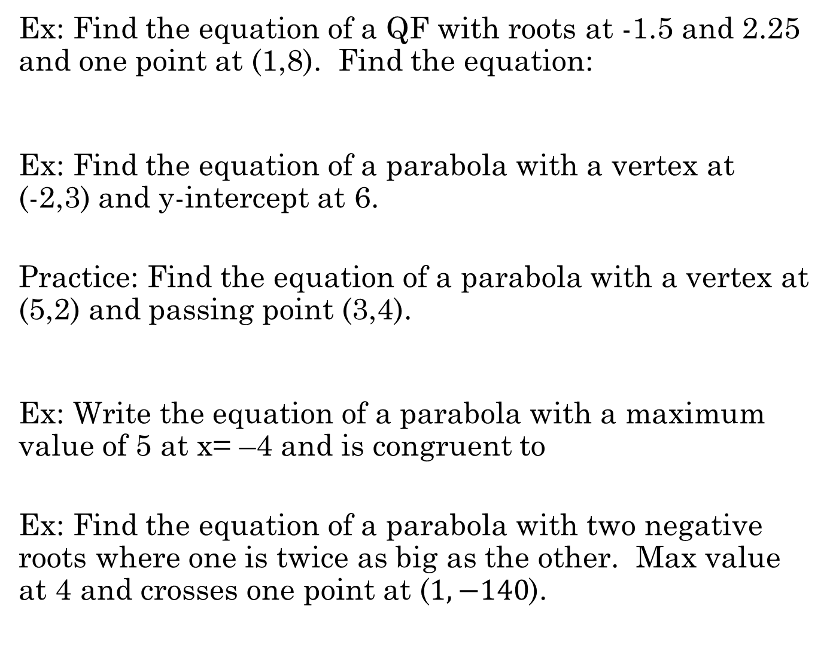
Ex: Find the equation of a QF with roots at -1.5 and 2.25 and one point at (1,8). Find the equation:
Ex: Find the equation of a parabola with a vertex at (-2,3) and y-intercept at 6.
Practice: Find the equation of a parabola with a vertex at (5,2) and passing point (3,4).
Ex: Write the equation of a parabola with a maximum value of 5 at x= –4 and is congruent to
Ex: Find the equation of a parabola with two negative roots where one is twice as big as the other. Max value at 4 and crosses one point at ($1,−140$).

Slide 4
Ex: Find the equation of a QF with roots at -1.5 and 2.25 and one point at (1,8). Find the equation:
Method 2:
PLUG in point (1,8)
Now you have your binomials!
Your equation will be:
Solve for “a” by plugging in point (1,8)

Slide 5
Ex: Find the equation of a parabola with a vertex at (-2,3) and y-intercept at 6.
1st: When the vertex is given, constants “p” and “q” are also given
2nd: We need an additional point to find the missing constant “a”. Plug the coordinates and solve for “a”
Coordinates of y intercept is (0,6)
The equation is of the parabola is:

Slide 6
Practice: Find the equation of a parabola with a vertex at (5,2) and passing point (3,4).
Coordinates of point is (3,4)
Ex: Write the equation of a parabola with a maximum value of 5 at x= –4 and is congruent to
Has a Maximum Value, so it opens down
Maximum value of 5 at x = –4
The equation is of the parabola is:

Slide 7
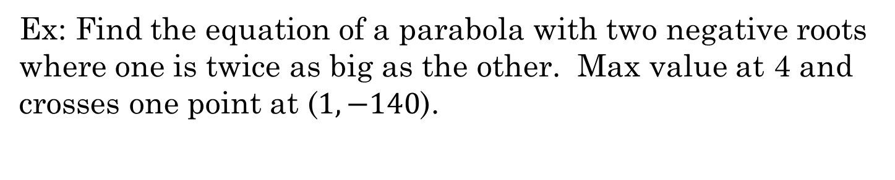
Ex: Find the equation of a parabola with two negative roots where one is twice as big as the other. Max value at 4 and crosses one point at ($1,−140$).
Write in factored form:
Write in APQ form:

Slide 8
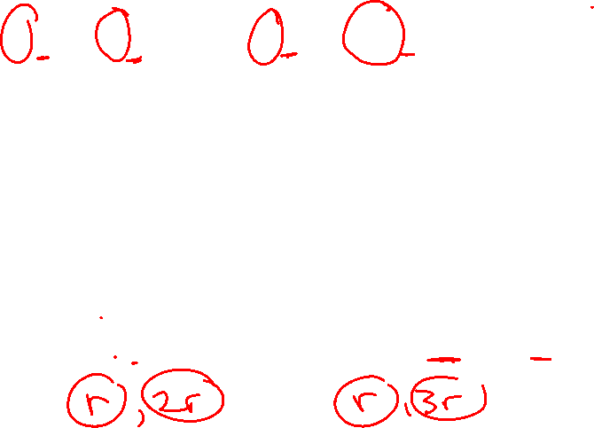
III) Finding Missing Constants when One root is Double/Triple the Other
Preview: Find the value of “k”
The coefficients of x², x, and constant term must be equal
Solve the equation with one missing variable first. You can’t solve an equation with two unknowns!!!
Given a formula with a missing constant “K” and told that one root is either “Double” or “Tripled” the other
Let the first root be “r” and the second root be “2r” or “3r”
Rewrite the equation in factored form
FOIL (Expand)
Compare the coefficients x², x, and constant to solve for “K”

Slide 9
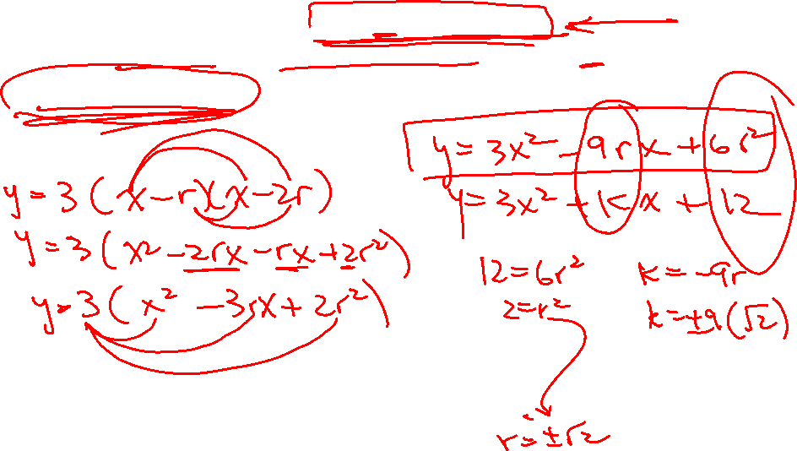
Ex: Given the equation: where one roots is double the other, find “k”
Ex: Given the equation: where one roots is triple the other, find “k”

Slide 10

Ex: Given the equation: where one roots is triple the other, find “k”

Slide 11
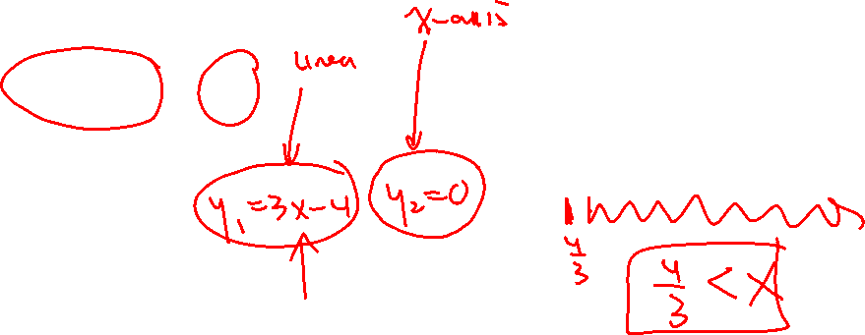
Solving Linear and Quadratic Inequalities
One way to solve inequalities is to visualize it like a graph
Suppose you are given the inequality below:
The left side of the equation is a linear graph (straight line)
The right side of the equation is a horizontal line (y=0) is the x-axis
The inequality in the middle is looking for parts of the graph where the “line” is “Greater” (ABOVE) the X-axis!
So where is your answer??
Straight line:
Hor. Line
X-axis
Your answer will be from the intersection point and greater b/c the red line is above the axis from here and beyond

Slide 12
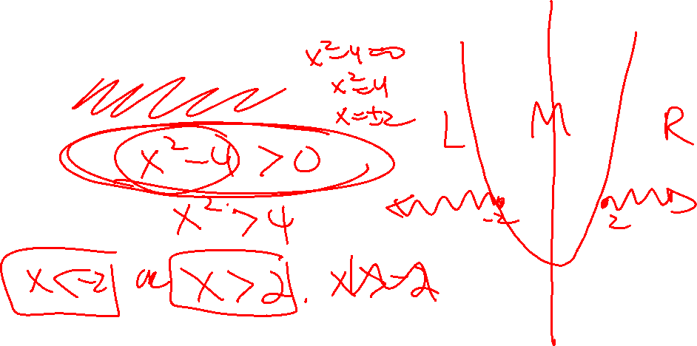
If you are solving a quadratic inequality, do the same thing and visualize as a graph
The left side is a parabola, factor it to find the x-intercepts
The right side, again, is the x-axis [y=0]
The inequality says that we want parts of the graph where the parabola is greater (above) the x-axis!
This is a parabola with x-intercepts at x=4 and x=-1
From the graph, you can see that the answer is the “outside” (left and right)
Your answer will be these two separate parts where the parabola is above the X-axis

Slide 13
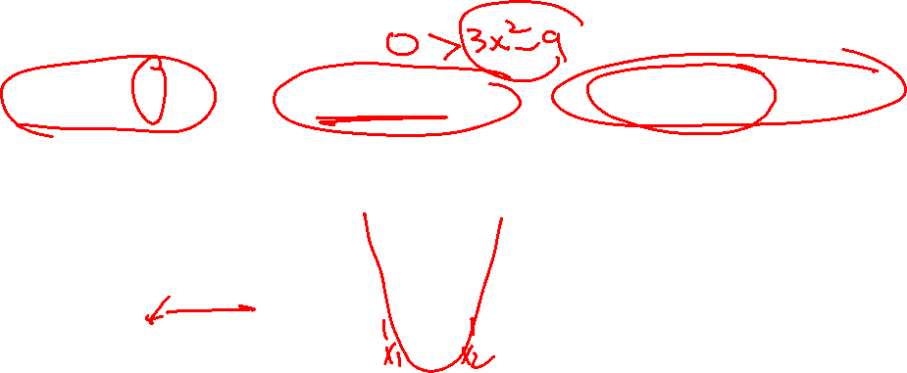
Steps for Solving Quadratic Inequalities:
If linear, solve directly, If Quadratic move all terms to one side so that one side of the equation becomes “zero” (make it the x-axis)
Solve for “x” → these will become the intersection points
Sketch the graph and use the inequality to determine if you are looking for parts that are “Above” “Below” or “equal” to the X-axis
You want parts of the “LINE” that is “LESS than and Equal” to the X-axis
You want parts of the “PARABOLA” that is “Greater/Above” the X-axis
You want parts of the “PARABOLA” that is “ABOVE” than the X-axis

Slide 14

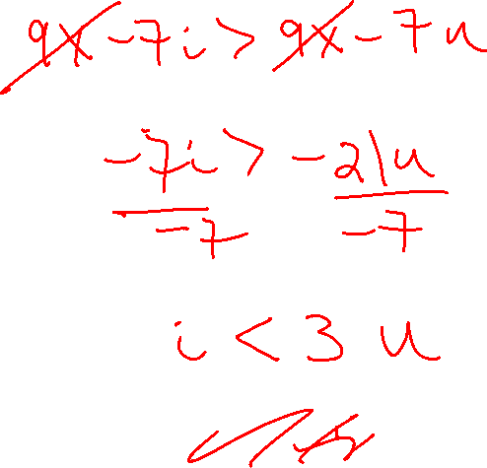
Q: What did the boy say when he met the girl of his dream?
$$9x−7i>3(3x−7u)$$

Slide 15
Practice: Solve each of the following inequalities

Slide 16
This one is quadratic, so find the x-intercepts first
The part of the parabola that is “UNDER” the x-axis is in between the two roots
This one is quadratic, so find the x-intercepts first
The part of the parabola that is “ABOVE” the x-axis is outside of the two roots (left/Right)

Slide 17
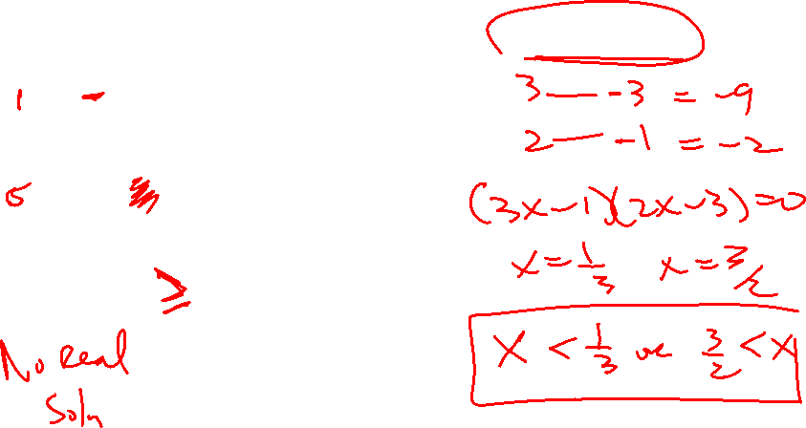
This is also Quadratic, but you will need algebra to factor and find x-intercepts
This one obviously needs algebra to isolate and factor
The part of the parabola that is under the x-axis is between the two roots
The part of the parabola that is ABOVE the x-axis is Outside the two roots
This one is a tricky one. If you CTS the eqn on the left, you realize that it is a parabola with no x-intercepts and is completely above the x-axis
Since the parabola is never under the x-axis b/c it opens up and shifted up, there will be no solution!

Slide 18

II) “DISCRMINANT”: Nature of the ROOTS
In this next part of the lesson, we want to determine how many x-intercepts a QF will have by looking at the “Discriminant”
The “Discriminant” will determine the “Nature of the Roots”, which refers to the “Number of X-intercepts” that a Quadratic Function will have
A Quadratic function (Parabola) can have either
2 distinct roots (2 different x intercepts)
2 equal roots (1 distinct root, double root)
No real roots (no x intercepts)
Use the “Discriminant Formula” to find the Nature of the roots:
The “discriminant” comes from your Quadratic formula!
This is your discriminant formula

Slide 19
II) Discrminant
y
There will be 2 distinct roots
x
-2
-1
0
1
2
-
-
0
x
y
4
4
There will be a double root/
2 equal roots. Which is one distinct root!
-1
0
1
2
3
x
x
0
y
4
If the discriminant is negative, you will have no real roots! (No X-intercepets)
-2
-1
0
1
2
x
x

Slide 20
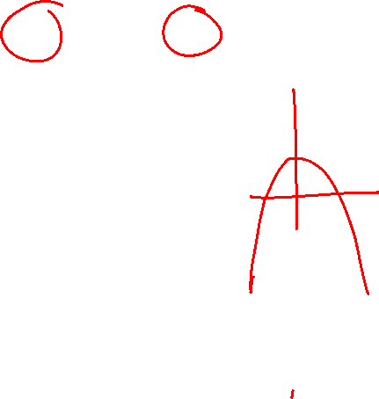
Ex: Determine the nature of the roots for each equation: (Do not Solve)
Discriminant is negative → There are no real roots
Discriminant is positive → There are 2 real roots

Slide 21
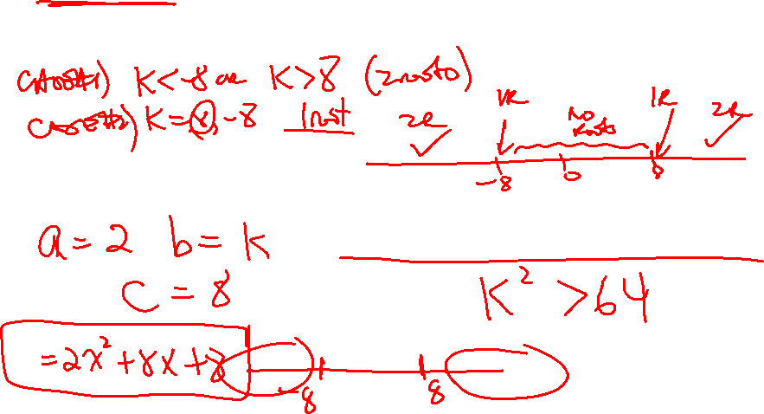
Altering the Nature of your Roots
In this next part, you will have an unknown constant “k” in your quadratic equation
You want to know what values of “k” will there be: Case 1: 2 roots Case 2: 1 root or Case 3: Zero roots
Suppose, we start with “case 1”, for what values of “k” will there be 2 ROOTS?
Treat the constant “k” like the variable “x”, our inequality becomes a quadratic equation
We want the equation to have 2 different roots, so the discriminant must be greater than zero
The part of the parabola that is above the x-axis is outside (left and right)
So this means that if “k” is either less than -8 or bigger than 8, the QF will have 2 different roots

Slide 22

Practice: For each of the Quadratic equations below, find the value of “k” so that the equation will have:
a) Two different roots b) Two equal roots
c) No real roots
Ex: Given the equation below, for what values of “k” will the equation have 3 different real roots?

Slide 23
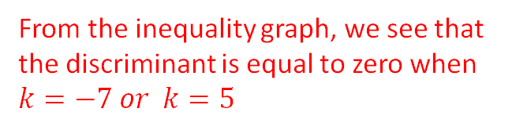

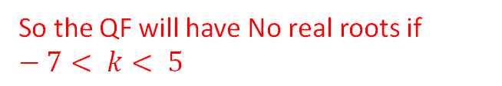
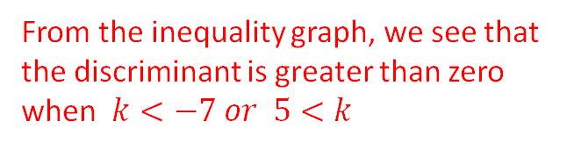
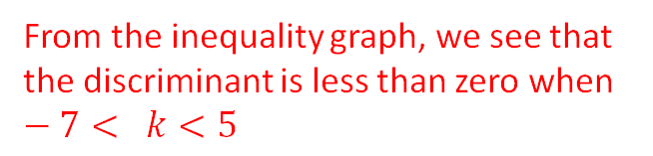
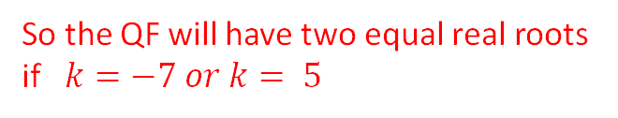
Practice: For what values of “k” does the equation have
a) Two different root b)Two Equal roots c) No real roots
Plug the values of “a”, “b”, and “c’ into the discriminant formula, then use the number of roots to determine the inequality sign:
Since you want two roots, the discriminant is greater than zero
Find the roots to the inequality first
From the inequality graph, we see that the discriminant is greater than zero when $k<−7 or 5<k$
So the QF will have two different real roots if $k<−7 or 5<k$
From the inequality graph, we see that the discriminant is equal to zero when $k=−7 or k=5$
So the QF will have two equal real roots if $k=−7 or k= 5$
From the inequality graph, we see that the discriminant is less than zero when $−7< k<5$
So the QF will have No real roots if $−7< k< 5$

Slide 24
Practice: For what values of “k” does the equation have
a) Two different root b)Two Equal roots c) No real roots
Plug the values of “a”, “b”, and “c’ into the discriminant formula, then use the number of roots to determine the inequality sign:
Since you want two roots, the discriminant is greater than zero
Find the roots to the inequality first
This means that your discriminant will never be equal to zero. Instead, it will always be “GREATER” than zero, despite what the value of “k” is
The equation will have 2 distinct roots for all real values of “k”
The equation can not have 2 distinct roots for all any value of “k”
The equation can not have no roots for all any value of “k”

Slide 25
Ex: Given the equation below, for what values of “k” will the equation have 3 different real roots?

